Slide 1
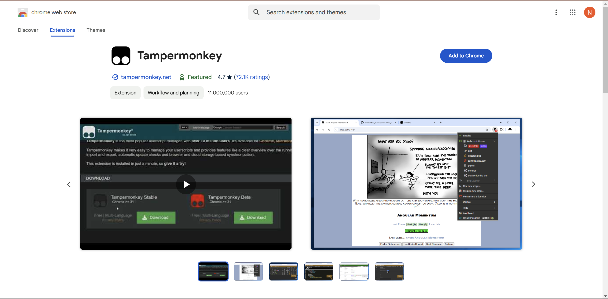
Download Tampermonkey extension for Chrome

Slide 2
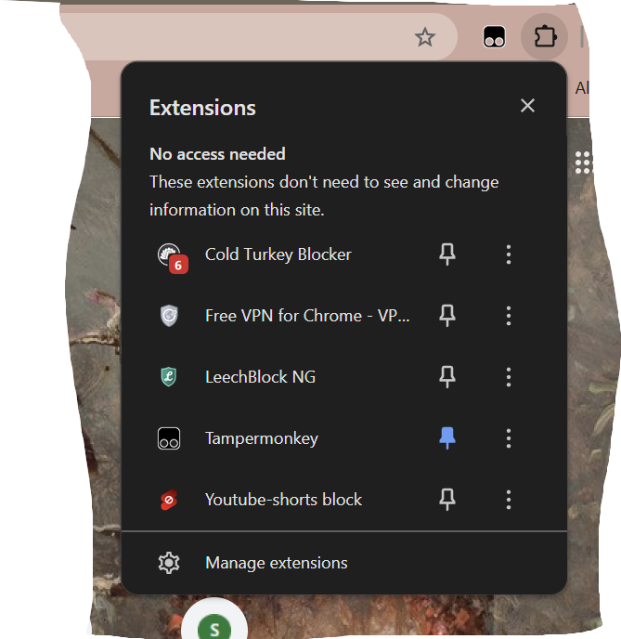
Open your extensions. Pin Tampermonkey by clicking the pin so it turns blue. Then
Open Tampermonkey by clicking on it.

Slide 3
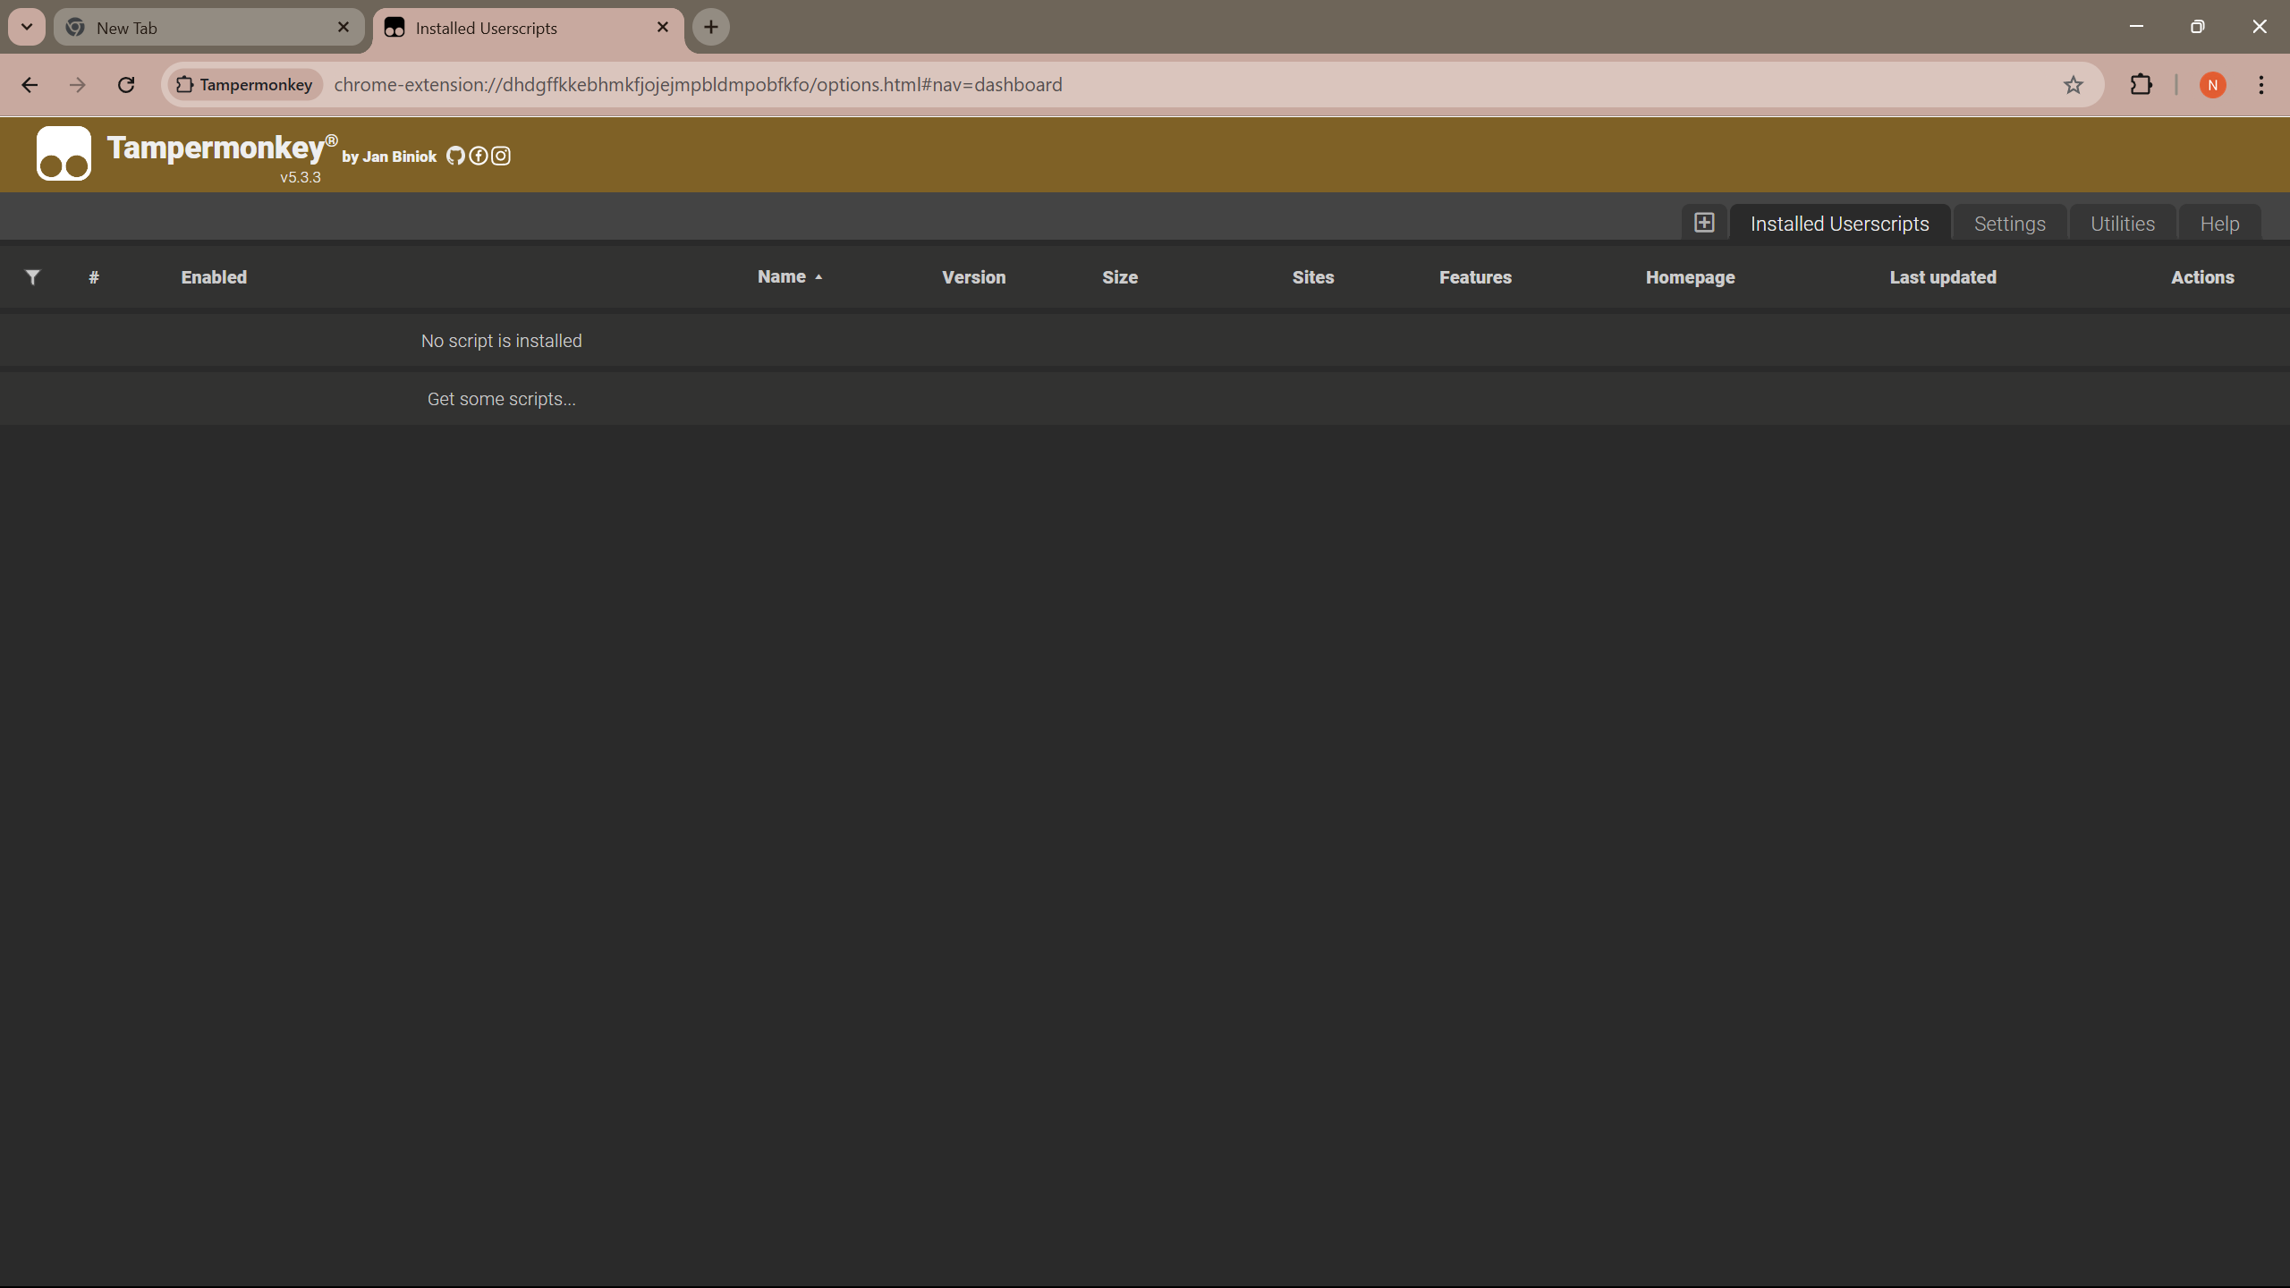
Opening Tampermonkey extension will bring you to 'Installed Userscripts' page seen below.
Now click on plus tab to the left of 'Installed Userscipts' tab, highlighted by red circle below.

Slide 4
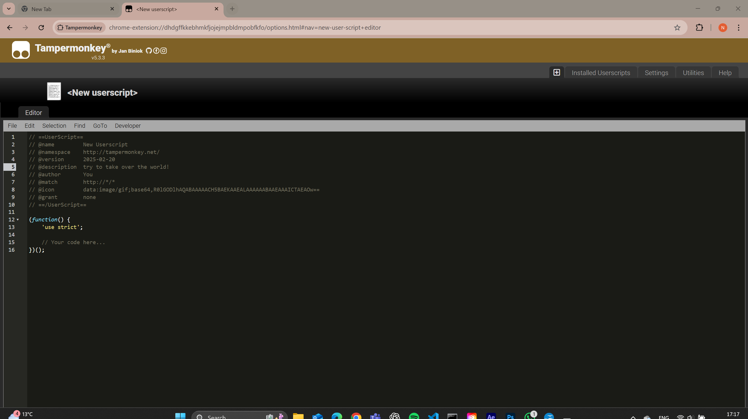
This will bring you here (now you can write a new script):

Slide 5
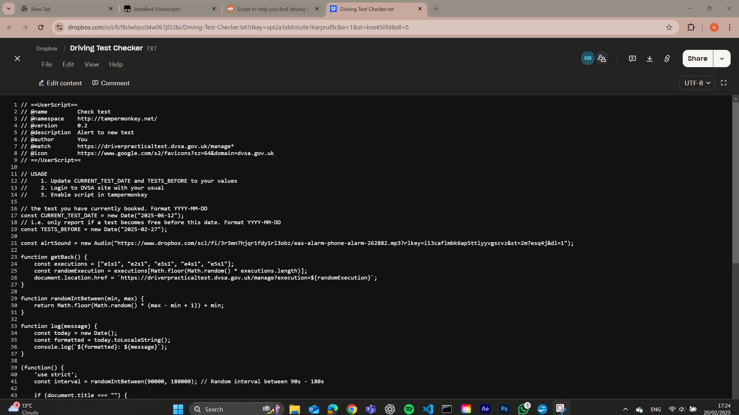
This link has the new script that you want to copy over into Tampermonkey (TM).
https://www.dropbox.com/scl/fi/l9clwlqvc04w067jf23bi/Driving-Test-Checker.txt?rlkey=vpt2a1xblrziu0e1karpruf9c&e=1&st=kne450fd&dl=0
Open it up and copy the entire script from line 1 to line 86.

Slide 6
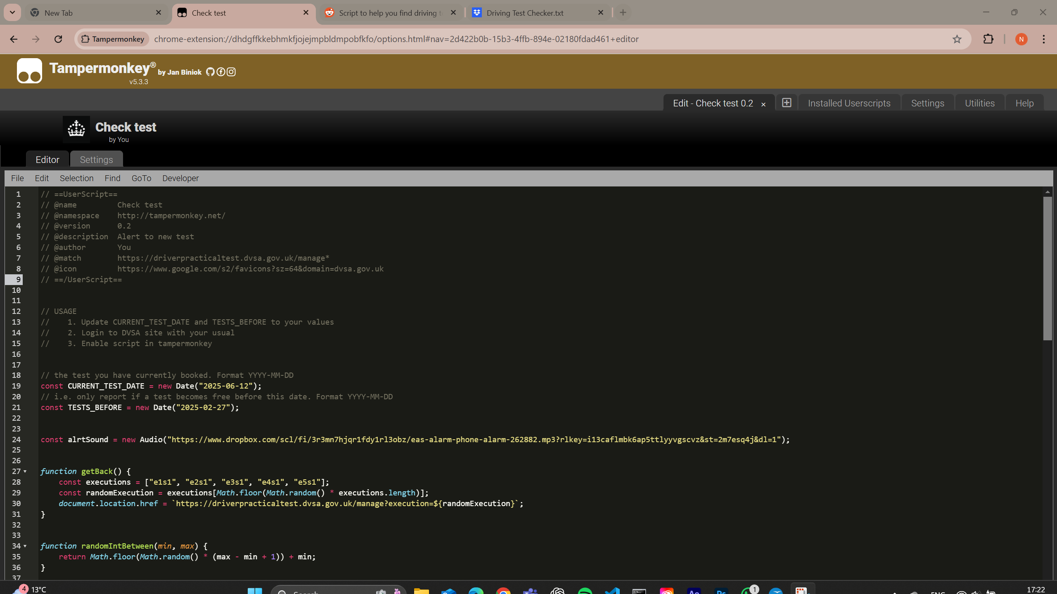
Make sure you remove the all the writing in TM first and then copy the entire script over.

Slide 7
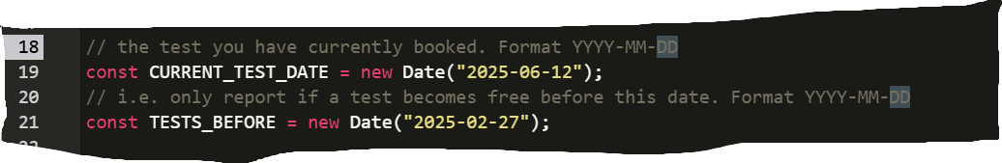
Now you need to update the script for your test that you want to change.
Input your current test date on line 19 by editing the yellow numbers, maintaining the format.
My test date was on 12th of June (you have to have already booked a test for this to work.)
Then update line 21 with the latest test date you want. So I wanted to be alerted to any test
Before 27th feb.

Slide 8
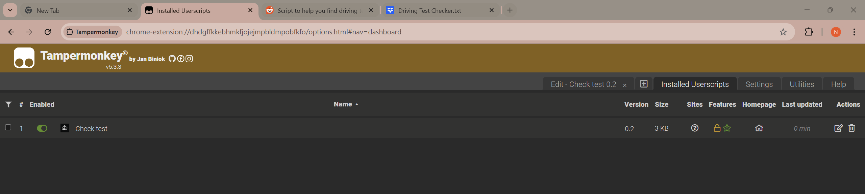
Now click File → Save
Go back to 'Installed Userscripts' and make sure the script is enable with the green toggle
Highlighted below in the red circle.
Make sure script is enabled. See green
Toggle.

Slide 9
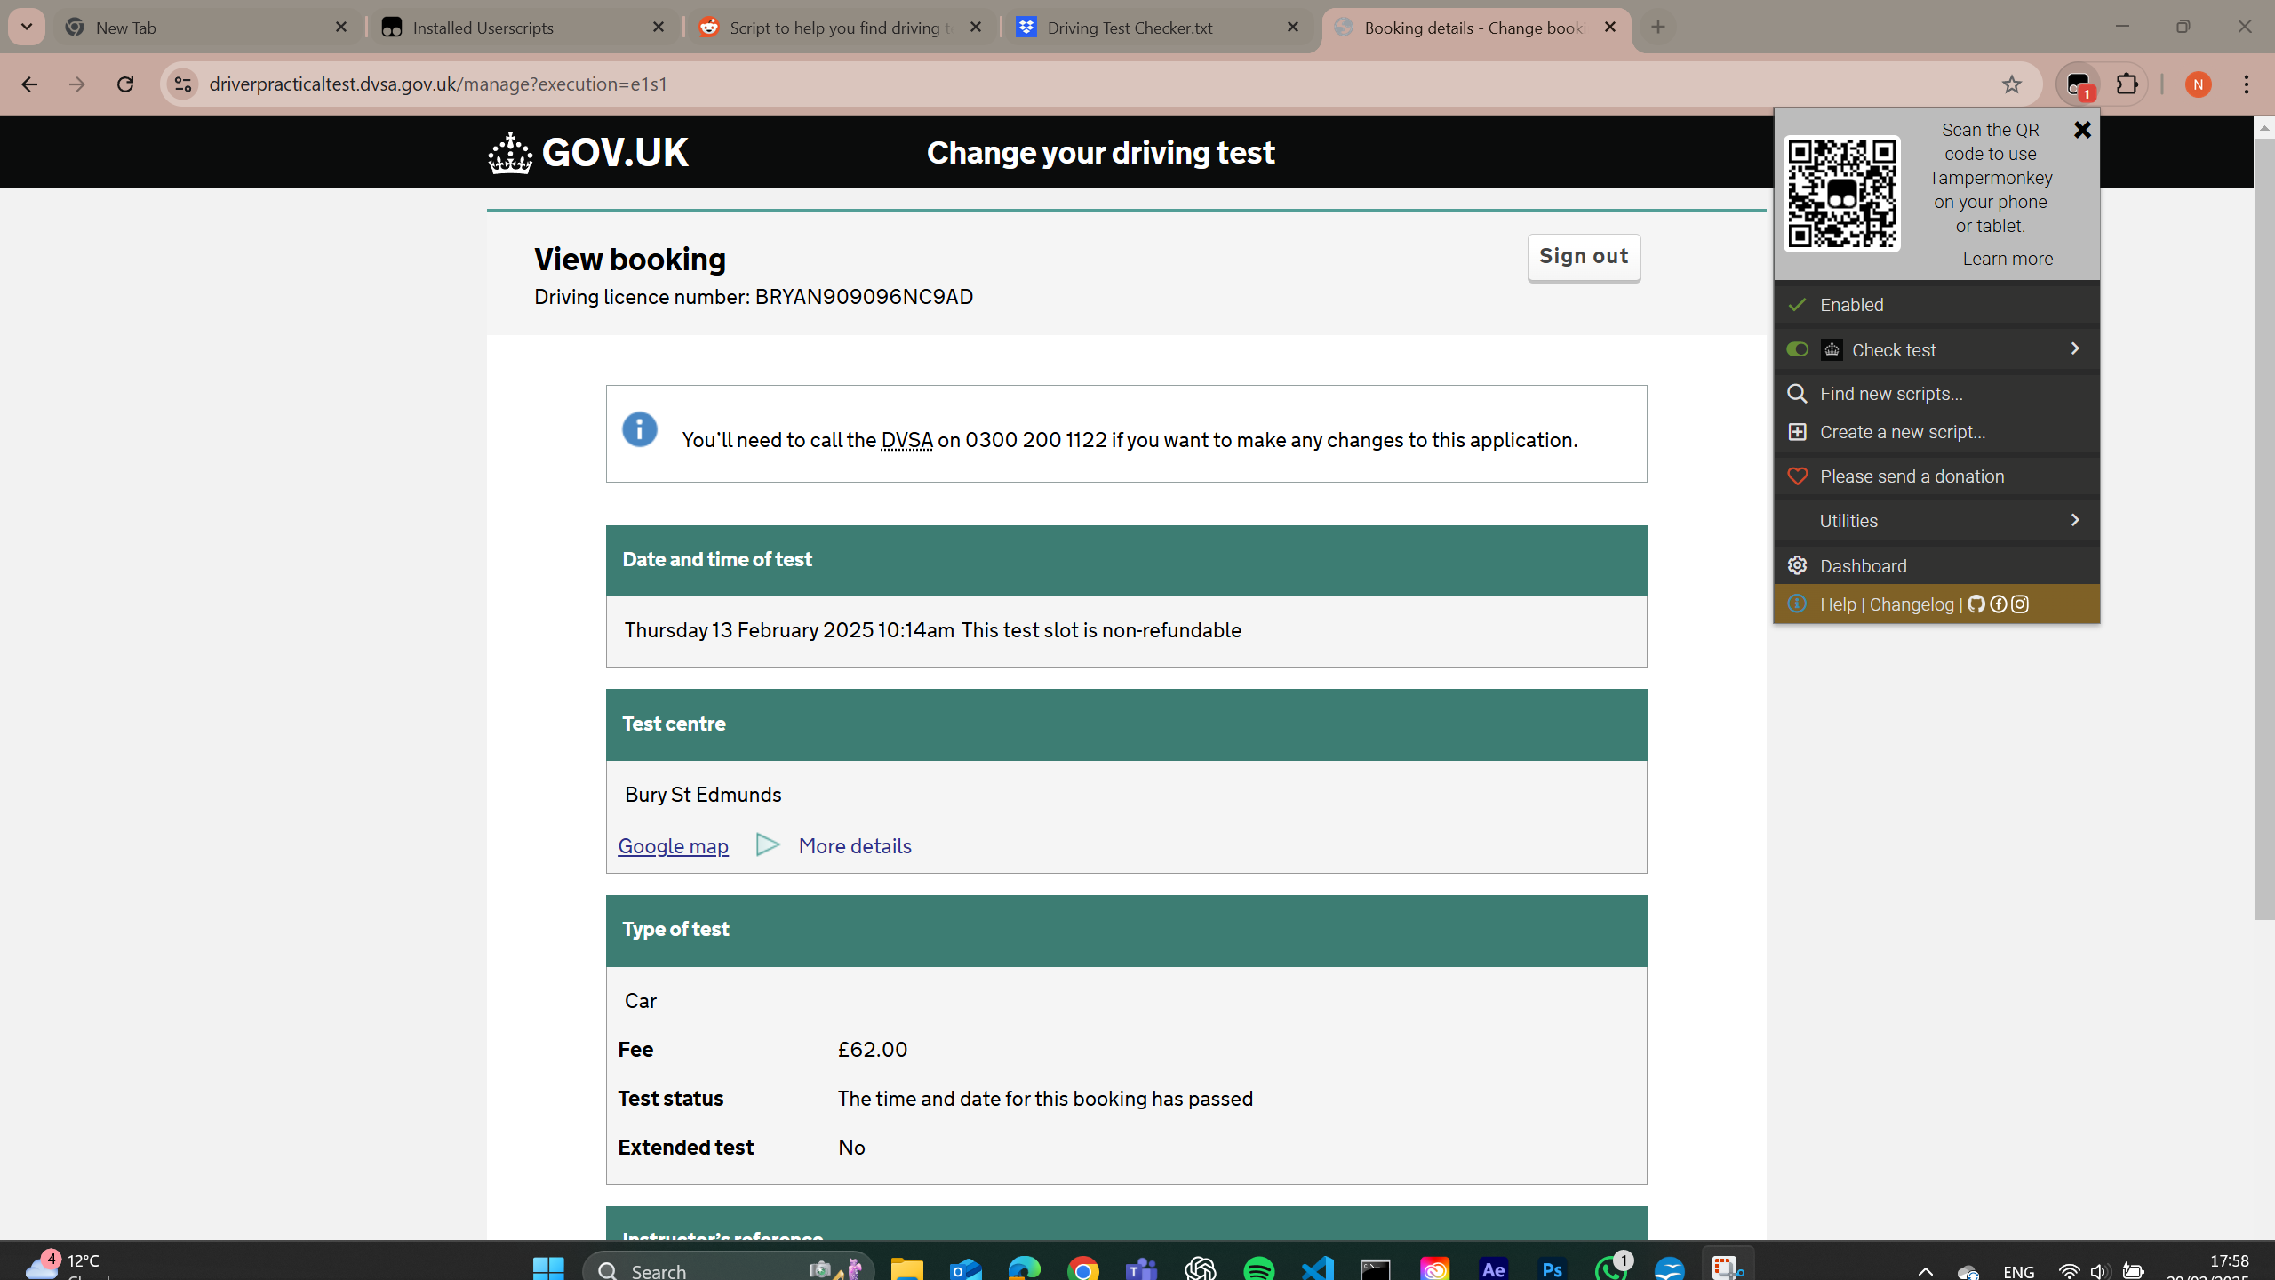
Login to DVSA website to change test. Input your details.
You will see a different screen to the one below because I have now passed my test.
Click on TM extension, click toggle to green, the script will now automatically search for a test
every minute or so and when one arises at your centre, before the date you have entered, an
Alarm will sound on the computer. You need to keep your computer on and running (not asleep).

